Slide 1
Stock Price Prediction using
Sentiment Analysis
Lance Ding, Tommy Kang

Slide 2
AIM
To predict the change in stock price based on news headlines

Slide 3
Sentiment Analysis & Machine Learning
Sentiment Analysis is a use case natural language processing and deep learning,
Where text is classified into categories (e.g. a Positive/Negative review or a Happy/Sad tweet)
Machines can process data much faster than humans.

Slide 4

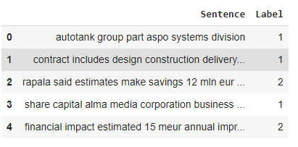
Dataset
The dataset we used to train the model is from the Inspirit AI program’s Natural Language Processing for Finance project

Slide 5
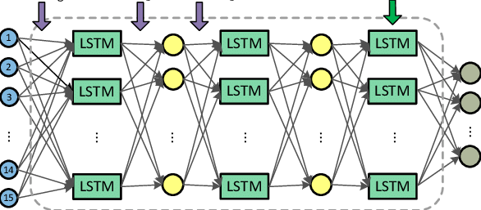
The model
We implemented the model using a LSTM layer in the Sequential model of the Keras library to perform sentiment analysis.

Slide 6


Web Crawling
The python library Beautiful Soup was used to crawl the Headlines of BBC News.
The BBC news headlines were analysed to predict if it will have a positive / negative / neutral effect on the stock price of a certain company.

Slide 7
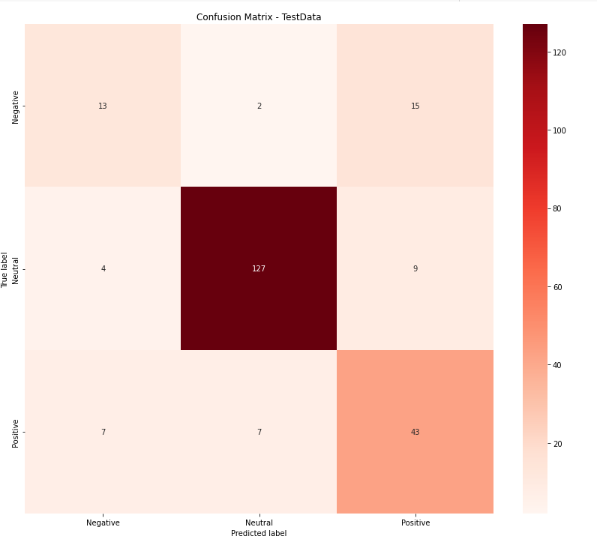
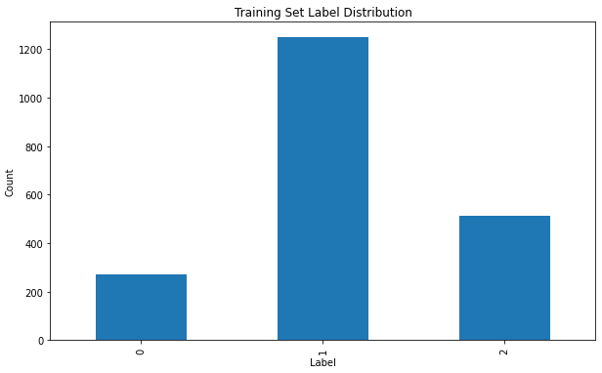
Model Outputs & Evaluation
The Model predictions were mostly Neutral, which could be due to the dataset not being balanced.

Slide 8
Conclusion
Performance is not bad, however it could be better. Much better.

Slide 9
Thank you

